Slide 1

StableSwap
Rongze GAO
Curve's StableSwap algorithm for a two-asset stablecoin pool (USDC/USDT, 6 decimals)
UPDATED: August 19, 2025

Slide 2
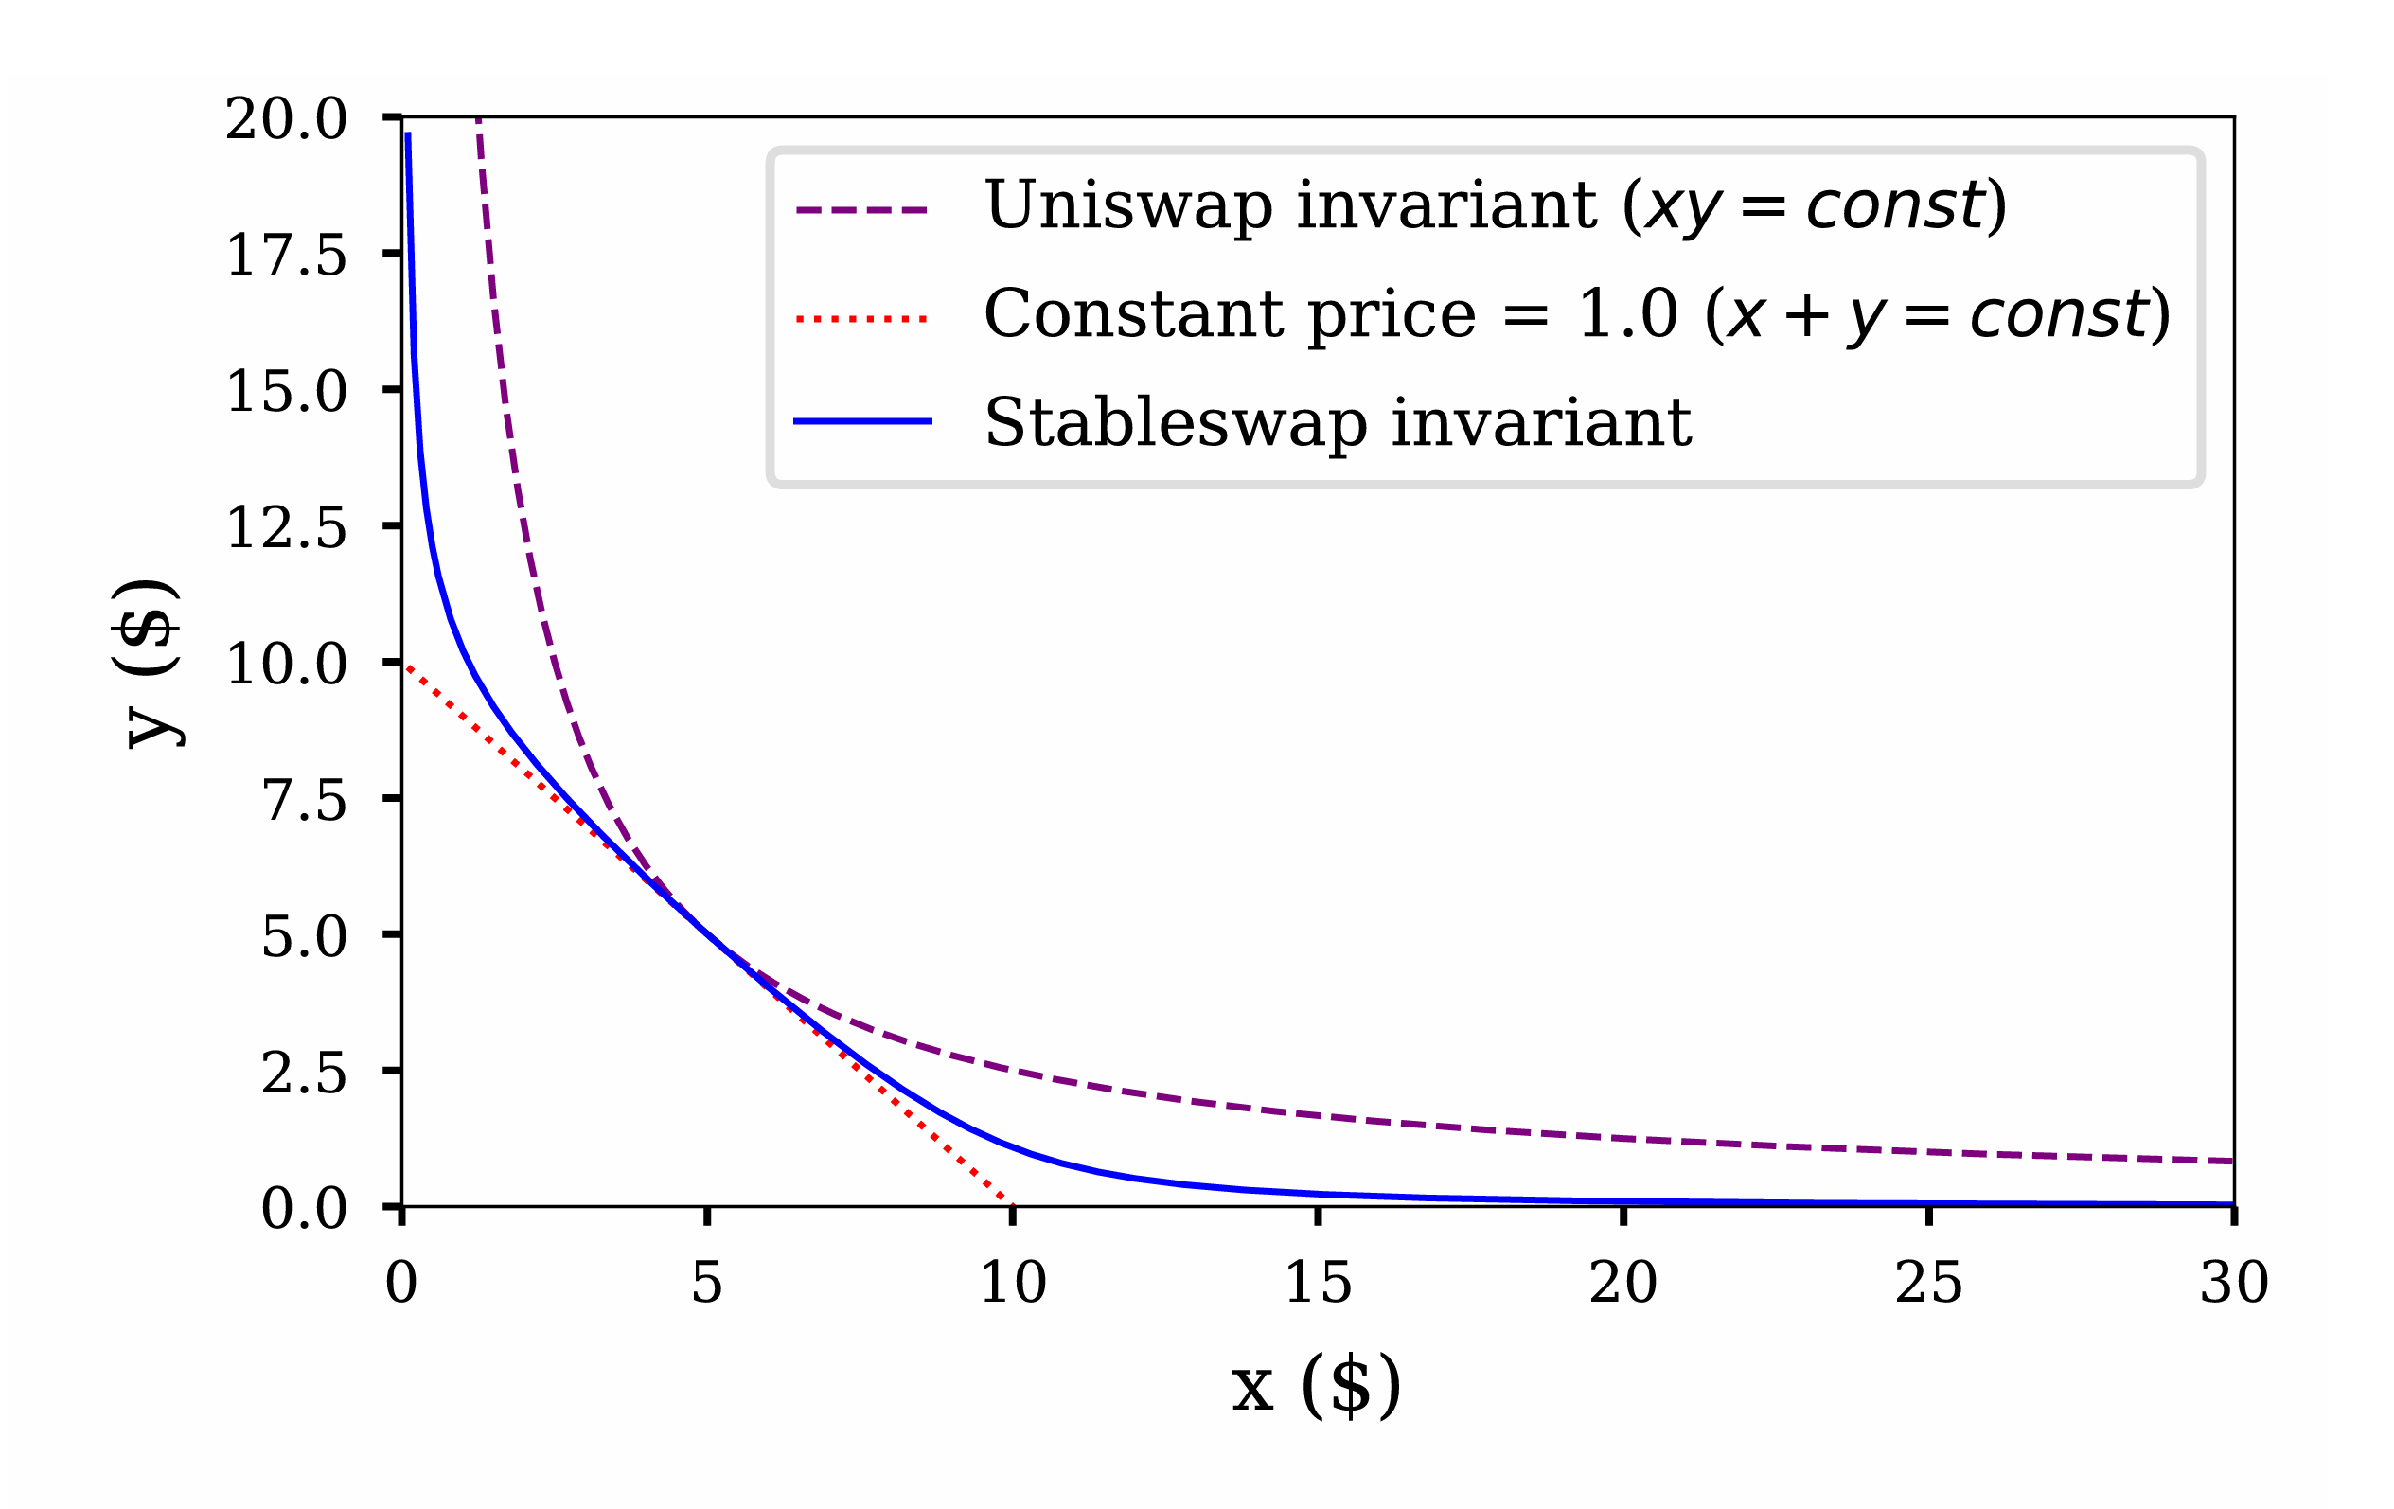


Research Background
1.
Research Background
Mathematical Principles
2.
3.
Library Demo and API
Code Analysis
XY=K
4.
X+Y=K
5.
Issues and Feedback
Citations, References, and Appendix
6.
BACKGROUND | PRINCIPLES | DEMO | CODE | ISSUES | REFERENCES

Slide 3

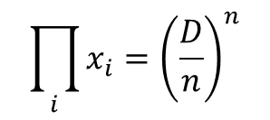
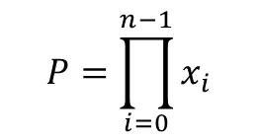
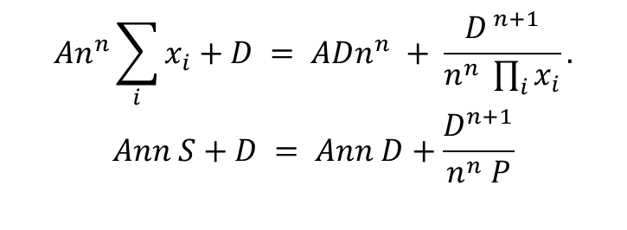
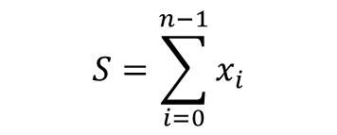
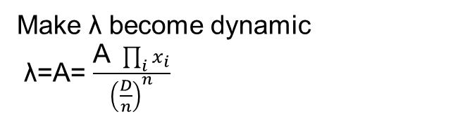
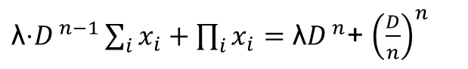
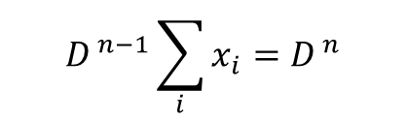
Mathematical Principles
Align the two in terms of dimensions
$\text{λ}\text{⋅}D^{ n−1}\sum_{i}{x_{i}}+\prod_{i}{x_{i}}={\text{λ}D}^{ n}$+ ${\left(\frac{D}{n}\right)}^{n}$
Make λ become dynamic
λ=A= $\frac{\text{A} \prod_{i}{x_{i}}}{{\left(\frac{D}{n}\right)}^{n}}$
X is balance vector (x,y)
$$P=\prod_{i=0}^{n−1}{x_{i}}$$
$$D^{ n−1}\sum_{i}{x_{i}}=D^{ n}$$
$$An^{n}\sum_{i}{x_{i}}+D = ADn^{n} + \frac{D^{ n+1}}{n^{n} \prod_{i}{x_{i}}}.$$
$$Ann S+D = Ann D+\frac{D^{n+1}}{n^{n} P}$$
$$\prod_{i}{x_{i}}={\left(\frac{D}{n}\right)}^{n}$$
$$S=\sum_{i=0}^{n−1}{x_{i}}$$
BACKGROUND | PRINCIPLES | DEMO | CODE | ISSUES | REFERENCES

Slide 4
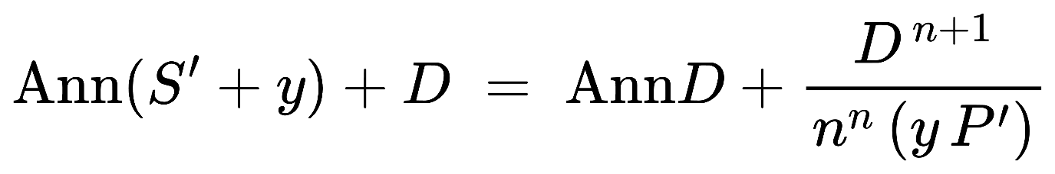
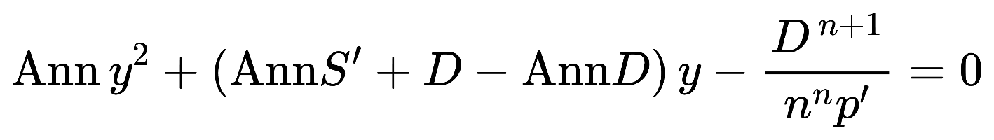
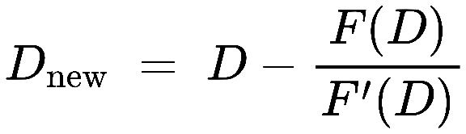
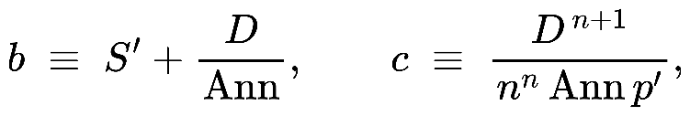
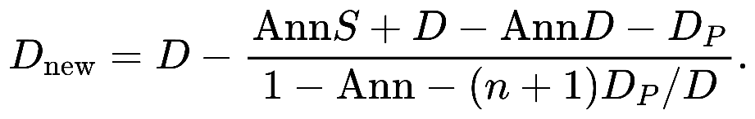
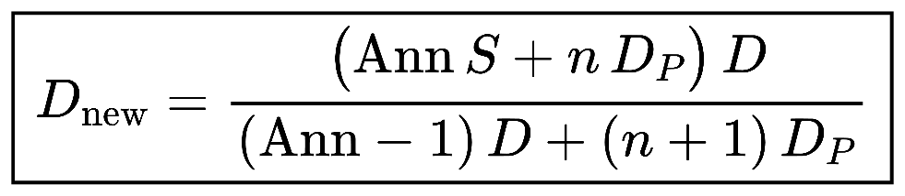
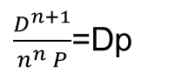
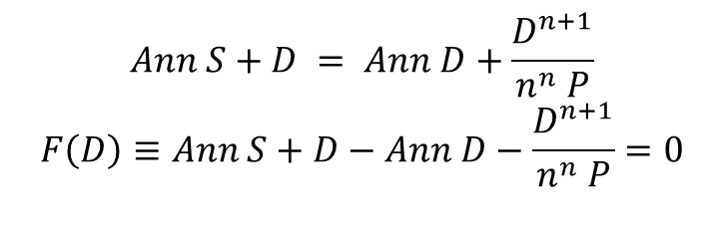
Mathematical Principles
Implicit root-finding problem
$\frac{D^{n+1}}{n^{n} P}$=Dp
Stable D and cal y
$$Ann S+D = Ann D+\frac{D^{n+1}}{n^{n} P}$$
$$F\left(D\right)≡Ann S+D−Ann D−\frac{D^{n+1}}{n^{n} P}=0$$
Newton’s method
quadratic function
A single Newton step is
f(y)=y^2 + (b - D)y - c = 0
closed-form
BACKGROUND | PRINCIPLES | DEMO | CODE | ISSUES | REFERENCES

Slide 5
Library Demo and API
accelerated growth in revenue and profitability: Market share expansion
BACKGROUND | PRINCIPLES | DEMO | CODE | ISSUES | REFERENCES

Slide 6
Code Analysis
Revenue Projection
Revenue Compared to Peers
PROFITABILITY INDICATORS
Gross margin (%) | 15.5% | 19.9% | 14.9% | 13.4% | 10.4% | 13.7% | 15.0% | 13.8% | 13.2% | 12.6% | 11.6% | 9.9%
EBITDA margin (%) | — | — | — | 9.7% | 7.1% | 8.7% | 10.1% | 8.9% | 8.4% | 7.8% | 6.8% | 5.1%
EBIT margin (%) | 2.9% | 6.6% | 6.2% | 5.5% | 3.6% | 5.2% | 6.6% | 5.4% | 4.9% | 4.3% | 3.3% | 1.6%
NI margin (%) | 1.1% | 4.7% | 3.1% | 2.9% | 3.6% | 5.6% | 7.4% | 6.7% | 6.5% | 5.9% | 5.4% | 4.7%
ROE (%) | 3.6% | 15.3% | 8.3% | 8.4% | 11.0% | 20.4% | 21.9% | 19.2% | 19.1% | 15.4% | 12.7% | 9.8%
ROA (%) | 0.8% | 3.1% | 2.1% | 1.6% | 2.8% | 4.9% | 6.6% | 6.4% | 6.6% | 6.4% | 6.1% | 5.4%
Source: Team Analysis, Choice
BACKGROUND | PRINCIPLES | DEMO | CODE | ISSUES | REFERENCES

Slide 7
Issues and Feedback
DCF TARGET: ¥ 11.31
Cost of debt
6.29%
Cost of equity
5.25%
WACC
5.2%
Terminal growth
2.25%
Upside: 11.9%
Terminal Growth Rate |  |  |  |  |  |  |  | Terminal Growth Rate
 |  | 1.75% | 2.00% | 2.25% | 2.50% | 2.75% |  |  |  | 0.50% | 1.00% | 1.50% | 2.00% | 2.50%
WACC | 4.2% | ¥14.7 | ¥16.1 | ¥18.0 | ¥20.5 | ¥22.7 |  | WACC | 7.00% | 30% | 42% | 59% | 81% | 101%
 | 4.7% | ¥11.9 | ¥12.8 | ¥14.0 | ¥15.4 | ¥17.2 |  |  | 7.50% | 5% | 13% | 24% | 36% | 52%
 | 5.2% | ¥9.9 | ¥10.6 | ¥11.3 | ¥12.2 | ¥13.3 |  |  | 8.00% | -12% | -6% | 0% | 8% | 18%
 | 5.7% | ¥8.5 | ¥8.9 | ¥9.5 | ¥10.1 | ¥10.8 |  |  | 8.50% | -25% | -21% | -16% | -11% | -4%
 | 6.2% | ¥7.3 | ¥7.7 | ¥8.1 | ¥8.5 | ¥9.0 |  |  | 9.00% | -35% | -32% | -28% | -25% | -20%
Source: Team Analysis
BACKGROUND | PRINCIPLES | DEMO | CODE | ISSUES | REFERENCES

Slide 8


Citations, References, and Appendix
Probability | High |  | MR1
 | Medium |  | PR1
 | Medium | MR3 |  | OR2 | PR2
 |  |  |  | OR1 |  | MR2
 | Low
 |  | Low |  | Moderate |  | High
 |  | Impact
MR1 Competition Risk
Mitigating
1. Maintain its commitment R&D
Factors
2. Focus on enhancing brand awareness and cultivating customer loyalty
Valuation
Downward pressure on pricing
Impact
Reduce margins
Impact: - 23% from target price (a share price of ¥ 8.73)
Source: Team Analysis, Bloomberg
BACKGROUND | PRINCIPLES | DEMO | CODE | ISSUES | REFERENCES

Slide 9



Environmental, Social and Governance
Environment Focus
 | Pollution control
 | Climate change and carbon emissions
 | Natural ecological harmony
Social Focus
 | Sustainable Supply Chain
 | Employee Welfare and Diversity
 | Social Responsibility Contributions
Governance Focus
 | Effective communication
 | Business Ethics and compliance
 | Managerial balance
LEADER
Energy & Resource Consumption
Employers Number
LAGGARD
Water Consumption
Heavy use of water
Massive emissions of greenhouse gases
LOW levels of hazardous chemicals Management
LOW recycling of solar products
CAGR: 53.2%
Source: Team Analysis, Bloomberg, JKS Annual Report
OVERVIEW | E S G | INVESTMENT SUMMARY | FINANCIALS | VALUATION | RISKS

Slide 10
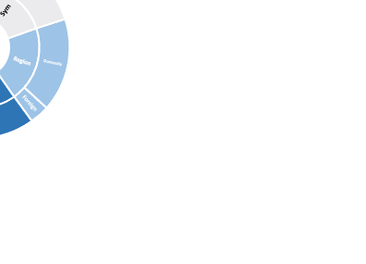
Environmental, Social and Governance
LEADER
Environment Focus
 | Pollution control
 | Climate change and carbon emissions
 | Natural ecological harmony
Social Focus
 | Sustainable Supply Chain
 | Employee Welfare and Diversity
 | Social Responsibility Contributions
Governance Focus
 | Effective communication
 | Business Ethics and compliance
 | Managerial balance
GOOD
JKS 2022 Staff Structure
Charitable Activities & Contributions
100% employee contracting
LAGGARD
Lower labor practices
Unstable product safety
Bad environmental impact
Non-significant stakeholder engagement
Source: Team Analysis, Bloomberg, JKS Annual Report
OVERVIEW | E S G | INVESTMENT SUMMARY | FINANCIALS | VALUATION | RISKS

Slide 11
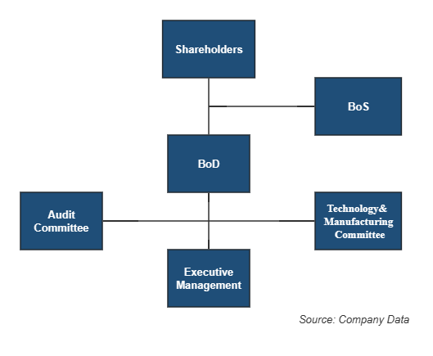
Environmental, Social and Governance
Environment Focus
 | Pollution control
 | Climate change and carbon emissions
 | Natural ecological harmony
Social Focus
 | Sustainable Supply Chain
 | Employee Welfare and Diversity
 | Social Responsibility Contributions
Governance Focus
 | Effective communication
 | Business Ethics and compliance
 | Managerial balance
LEADER
JKS’s Board Sturcture
CEO Compensation (mRMB)
LAGGARD
Top Ten Shareholders Holding Information
Rank | Name | Holding Proportion
1 | JKS Investment | 58.62
2 | Shangrao Jiarui | 3.45
3 | Shangrao Runjia | 3.16
4 | Shangrao Zhuoling II | 2.17
5 | Shangrao Zhuoqun | 2.11
6 | Xizang Yunshang | 2.10
7 | Fuzhou XingziRuiying | 2.07
8 | Shangrao Zhuoling | 1.45
9 | Xingye Guoxin | 1.38
10 | Xizang Yunshang II | 1.35
High proportion of non-independent directors
Lack of multinational and female directors
Lack of pay diversity
Risk of concentration of equity
Source: Team Analysis, Bloomberg, Choice
OVERVIEW | E S G | INVESTMENT SUMMARY | FINANCIALS | VALUATION | RISKS

Slide 12



INVESTMENT SUMMARY
Solar PV Development Wave: Global Market Position & Expanding Demand
Pioneering Green Evolution: Technological Superiority & Industry Primacy
accelerated growth in revenue and profitability: Market share expansion
OVERVIEW | E S G | INVESTMENT SUMMARY | FINANCIALS | VALUATION | RISKS

Slide 13
Global Market Position & Expanding Demand
Global Formation
World demand
280GW
2019A-2023E China’s Electricity consumption of the whole society
Global sales subsidiaries and production bases
160+
countries
Sales subsidiaries
Sales subsidiaries & Production bases
OVERVIEW | E S G | INVESTMENT SUMMARY | FINANCIALS | VALUATION | RISKS
Notes:
JKS在全球太阳能光伏行业保持领先地位，并积极拓展海外市场产业链布局。2022年，太阳能光伏市场蓬勃发展，中国市场用电量逐年上升，全球组件需求高达280GW。作为全球太阳能光伏组件行业的核心企业，JKS拥有较大的市场份额，销售网络已覆盖120多个国家和地区。截至2022年底，JKS已在中国、马来西亚、越南、美国等地建立了14个生产基地，员工总数超过4.6万人。

Slide 14
INVESTMENT SUMMARY
Solar PV Development Wave: Global Market Position & Expanding Demand
Pioneering Green Evolution: Technological Superiority & Industry Primacy
accelerated growth in revenue and profitability: Market share expansion
OVERVIEW | E S G | INVESTMENT SUMMARY | FINANCIALS | VALUATION | RISKS

Slide 15
Technological Superiority & Industry Primacy
With its N-type TOP-Con, JKS has an absolute leading position in the industry for its operational N-type cell production capacity.
R&D Expenses (2018A-2029E)
R&D Growth Compared to Peers
OVERVIEW | E S G | INVESTMENT SUMMARY | FINANCIALS | VALUATION | RISKS

Slide 16

Technological Superiority & Industry Primacy
Conversion efficiency & Component power broken world records
Superior Technology
Ranked first in global PV module shipments for 4 consecutive years
Higher R&D Spending
Long-term competitive advantage
Higher Return
The first component manufacturer in the world to ship more than 10GW of N-type components
Further consolidate the leading position in the industry
OVERVIEW | E S G | INVESTMENT SUMMARY | FINANCIALS | VALUATION | RISKS

Slide 17
INVESTMENT SUMMARY
Solar PV Development Wave: Global Market Position & Expanding Demand
Pioneering Green Evolution: Technological Superiority & Industry Primacy
accelerated growth in revenue and profitability: Market share expansion
OVERVIEW | E S G | INVESTMENT SUMMARY | FINANCIALS | VALUATION | RISKS

Slide 18
Accelerated Growth in Revenue and Profitability
Profitability Ratios
Revenue Projection
Source: Team Analysis, JKS Annual Report
OVERVIEW | E S G | INVESTMENT SUMMARY | FINANCIALS | VALUATION | RISKS

Slide 19
LEVERAGE AND LIQUIDITY
Total debt/EBITDA & D/E (x)
Liquidity Indicators
Leverage indicators compared to peers
Liquidity indicators compared to peers
Source: Team Analysis, Bloomberg, Choice
OVERVIEW | E S G | INVESTMENT SUMMARY | FINANCIALS | VALUATION | RISKS

Slide 20
COMPENSATION
EPS & DPS
Commitment to Reward its Shareholders
Developing Growth Companies
Growing Dividend Rate
OTHER
DPS | 0.00 | 0.00 | 0.00 | 0.02 | 0.09 | 0.14 | 0.21 | 0.24 | 0.28 | 0.34 | 0.37 | 0.38
Payout ratio | 0.0% | 0.0% | 0.0% | 16.1% | 30.3% | 23.2% | 23.2% | 23.2% | 23.2% | 25.2% | 25.2% | 25.2%
Source: Team Analysis
OVERVIEW | E S G | INVESTMENT SUMMARY | FINANCIALS | VALUATION | RISKS

Slide 21













SUPPORTING MODELS: RELATIVE VALUATION
 | Solar PV Manufacturing |  | Solar Power Plant Development & Operation |  | New Energy Technologies & Solutions |  | JKS Applied Multiple 2023 |  | Target Price & Upside
EV/ EBITDA | 6.8x |  | 13.3x |  | 14.1x |  | 13.3x
P/E | 10.9x |  | 17.0x |  | 31.2x |  | 17.0x
Valuation Football Field
¥ 12.70 26%
¥ 12.24 21%
Current Price
¥10.11
Target Price
¥11.31
Source: Team Analysis, Bloomberg
OVERVIEW | E S G | INVESTMENT SUMMARY | FINANCIALS | VALUATION | RISKS

Slide 22



SUPPORTING MODELS: DCF SCENARIOS
Scenario Analysis Projected FCFF
FCFF DCF | Bull | Base | Bear
COGS/REV CAGR | 21.29% | 21.27% | 21.25%
OPEX CAGR | 23.03% | 23.20% | 23.38%
FCFF CAGR | 8.56% | 6.94% | 4.75%
Terminal Growth | 2.40% | 2.25% | 2.10%
WACC | 5.0% | 5.2% | 5.3%
Stock Price | ¥15.00 | ¥11.31 | ¥8.28
Upside | 48.4% | 11.9% | -18.1%
Source: Team Analysis
OVERVIEW | E S G | INVESTMENT SUMMARY | FINANCIALS | VALUATION | RISKS

Slide 23


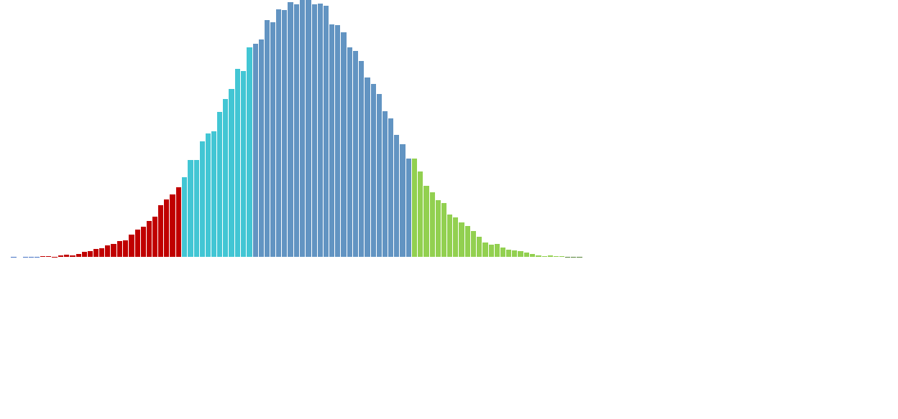
SUPPORTING MODELS: MONTE CARLO
SIMULATION STATISTICS
Trials |  |  |  |  | 100000
Target Price |  |  |  |  | ¥11.31
25th percentile |  |  |  |  | 11.26
Mean |  |  |  |  | 12.34
Mean upside% |  |  |  |  | 22%
Median |  |  |  |  | 12.34
75th percentile |  |  |  |  | 13.41
Standard deviation |  |  |  |  | 1.598
Coefficient of Variation |  |  |  |  | 7.724
Skewness |  |  |  |  | 0.010
Kurtosis |  |  |  |  | 0.018
%above 10%upside |  |  |  |  | 78%
%bull scenario |  |  |  |  | 5%
78% of the outcomes indicate a share price exceeding the current price by more than 10%,
Parameters Stressed
WACC
Terminal Growth Rate
Sales
COGS
100,000
Number of Trials
Current Price
¥10.11
Target Price
¥11.31
Source: Team Analysis
OVERVIEW | E S G | INVESTMENT SUMMARY | FINANCIALS | VALUATION | RISKS

Slide 24
No high probability-high impact risks identified
Probability | High |  | MR1
 | Medium |  | PR1
 | Medium | MR3 |  | OR2 | PR2
 |  |  |  | OR1 |  | MR2
 | Low
 |  | Low |  | Moderate |  | High
 |  | Impact
PR2 International trade protection policy risk
Mitigating
1. Actively seek cooperation
Factors
2. Build stable and lasting relationships
Valuation
1. A decline in the company's sales revenue
Impact
2. Decrease in COGS/REV
Impact: - 38% from target price (a share price of ¥ 7.05)
Source: Team Analysis, Bloomberg
OVERVIEW | E S G | INVESTMENT SUMMARY | FINANCIALS | VALUATION | RISKS

Slide 25
No high probability-high impact risks identified
Probability | High |  | MR1
 | Medium |  | PR1
 | Medium | MR3 |  | OR2 | PR2
 |  |  |  | OR1 |  | MR2
 | Low
 |  | Low |  | Moderate |  | High
 |  | Impact
MR2 Turbulence of Macroeconomic Downturn Risk
Mitigating
Factors
1. Regional market share diversification
2. Implement a demand-oriented manufacturing approach
Valuation
1. Increase in WACC
Impact
2. Increase in COGS/REV
Impact: - 45% from target price (a share price of ¥ 6.18)
Source: Team Analysis, Bloomberg
OVERVIEW | E S G | INVESTMENT SUMMARY | FINANCIALS | VALUATION | RISKS

Slide 26
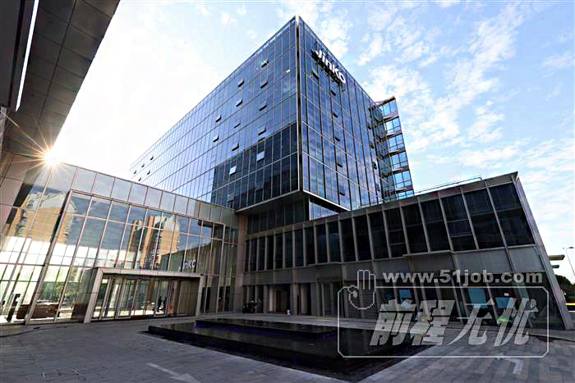
BUY ￥11.31
Superior Technology
Higher R&D Spending
Long-term competition advantages
Higher Return
RECOMMENDATION
“Harness The Power Of Solar Energy To Build Confidence As Radiant As The Sun.”

